Slide 1
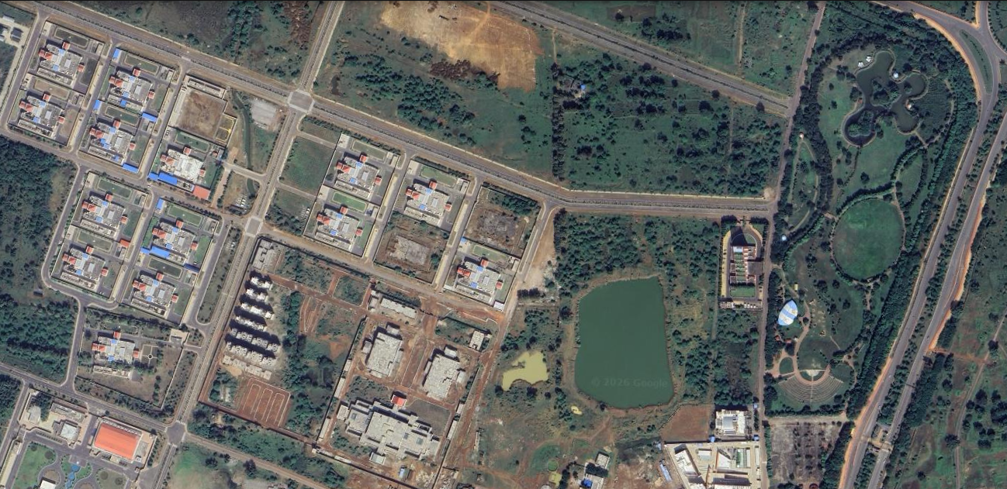
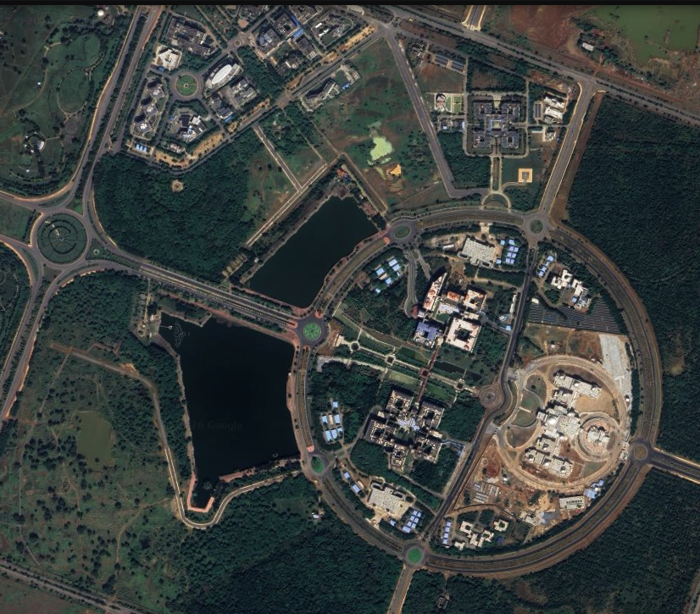
Udyog
Gadh
Automated Satellite Surveillance & Revenue Recovery System

Slide 2
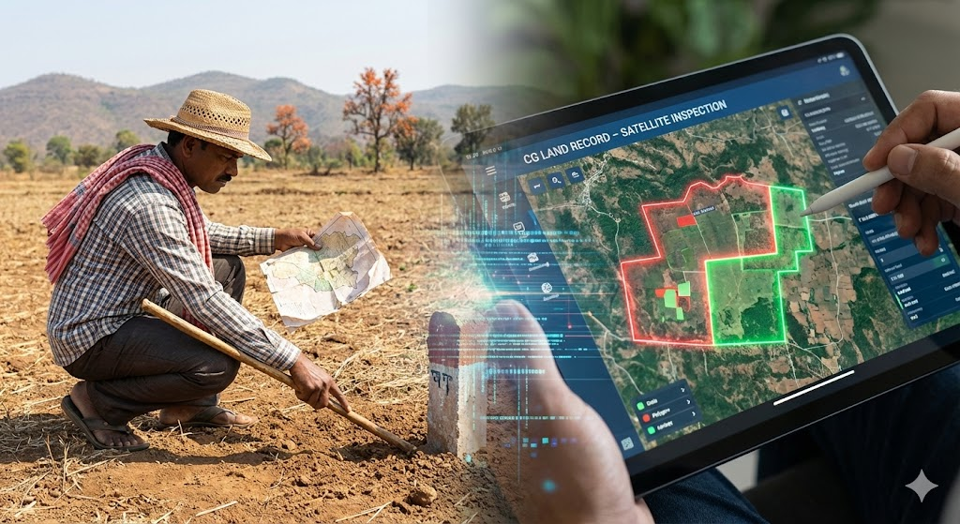
Executive Summary
The Challenge: CSIDC manages 5,000+ acres of land, but relies on slow, reactive manual surveys that miss critical violations.
The Solution: Udyog Gadh automates surveillance using Sentinel-1 (Radar) and Sentinel-2 (Optical) satellite data.
The Impact:
Real-Time Detection: Instantly flags encroachments (walls/sheds) and 'Ghost Plots' (vacant land).
Revenue Recovery: Stops tax leakage and automates legal notice generation.
All-Weather Vision: Radar technology ensures monitoring continues even during cloudy monsoon months.

Slide 3

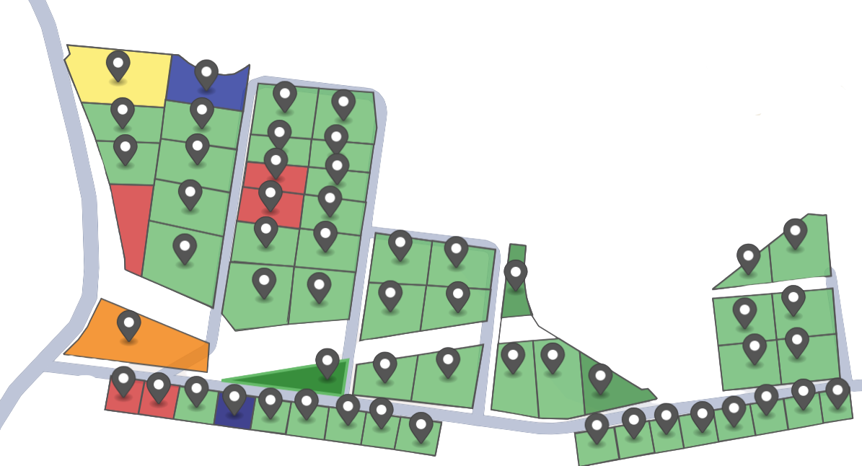
The Context
THE SCALE
TARGET AREA: CHHATTISGARH STATE INDUSTRIAL DEVELOPMENT CORP (CSIDC) ESTATES
THE ASSET
TOTAL LAND BANK: 5,000+ ACRES OF HIGH-VALUE INDUSTRIAL LAND
THE GOAL
TO MOVE FROM 'REACTIVE MANUAL CHECKS' TO 'PROACTIVE DIGITAL SURVEILLANCE'.

Slide 4



Current Reality
1. The Manual Bottleneck
Currently, safeguarding 5,000+ acres relies entirely on physical site inspections. With limited field officers, visiting every plot in Urla, Bhilai, and remote estates takes months, leaving vast areas unmonitored.
2. The Reactive Trap
Encroachments are often detected only after a complaint is filed. By then, temporary sheds have turned into permanent concrete structures, making legal eviction difficult and costly.
3. The 'Data vs. Ground' Gap
While CSIDC possesses official maps (The Truth), the ground reality changes daily. There is currently no real-time synchronization between the office database and the actual field status.

Slide 5

Why Manual Monitoring Fails
Problem 01
Impossible Scale
5,000+ acres vs. a handful of officers. Inspecting every plot in remote estates like Borai manually is logistically impossible, leaving massive areas unmonitored.
The current approach relies entirely on physical site visits and paper records. With limited field staff and vast territories across Chhattisgarh, this analog method creates a critical 'Visibility Gap' where violations go unnoticed for months.
Problem 02
Silent Losses
Vacant 'Ghost Plots' sit unallocated, and illegal encroachments pay zero tax. Without real-time data, the state loses crores in potential revenue every year.
Problem 03
Too Little, Too Late
Action is currently reactive. By the time a violation is reported and verified, temporary sheds have turned into permanent concrete structures, leading to years of litigation.

Slide 6
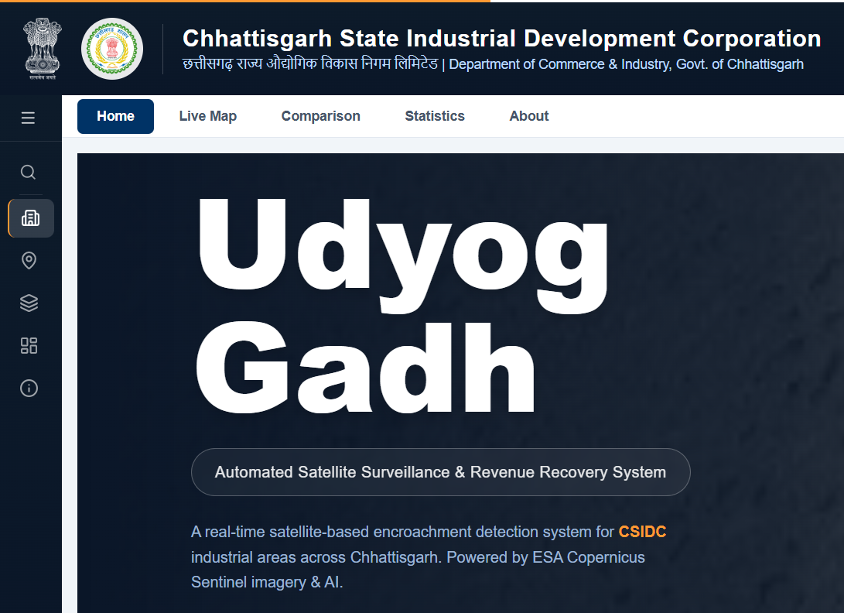
The Solution:
Udyog Gadh
Intelligent Surveillance
Automated Enforcement
We replace manual patrols with Sentinel-1 Radar Technology. Our system sees through clouds and weather to monitor all 5,000+ acres 24/7, instantly detecting unauthorized construction or vegetation loss.
Detection is nothing without action. The system cross-checks satellite data with official maps and auto-generates legal notices (PDFs) for violations, cutting enforcement time from months to minutes.

Slide 7

Data Fusion Layer
We combine Sentinel-1 Radar (which sees through clouds/rain) and Sentinel-2 Optical imagery with CSIDC's official Shapefiles (GeoJSON) to establish precise legal plot boundaries
The Intelligence Engine
Change Detection AI
Google Earth Engine algorithms calculate Backscatter Intensity (to spot new concrete structures) and NDVI (to measure vegetation). If the satellite data contradicts the legal boundary, an alert is triggered.
Our engine does not just look at pictures; it analyzes data. By fusing official government records with multi-band satellite imagery, we create a 'Digital Twin' of the industrial estate. This pipeline ensures that what happens on the ground matches what is in the files.

Slide 8
Strategic Objectives
Zero-Tolerance Surveillance
To achieve 100% monitoring coverage of all industrial estates (Urla, Bhilai, etc.), ensuring that every square meter of illegal encroachment is detected and flagged within a time.
The "Growth" Goal
Our primary mission is to empower the CSIDC with data-driven tools that eliminate uncertainty. By deploying Udyog Gadh, we aim to transform land governance from a passive, manual process into a proactive, digital operation that secures state assets and maximizes revenue.
To systematically identify non-operational 'Ghost Plots' and unbilled land usage, enabling the state to recover lost tax revenue and accelerate land re-allocation to active industries.

Slide 9
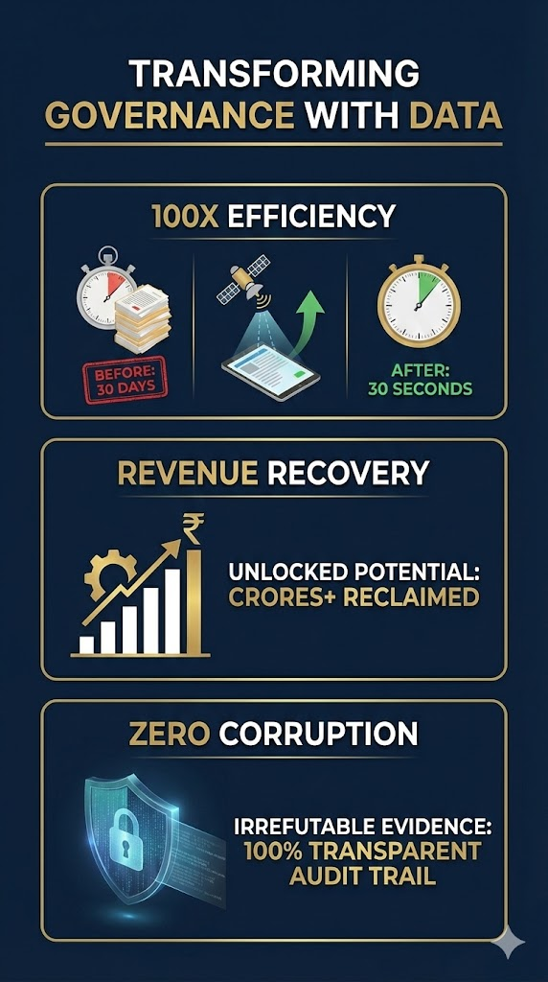
The Impact
Transforming Governance with Data : Implementing Udyog Gadh doesn't just digitize maps; it revolutionizes the state's revenue model.
100x Efficiency : Survey time reduced from 30 days to 30 seconds. What took a team of officers a month to inspect is now scanned instantly.
Revenue Recovery : We unlock crores in potential revenue by identifying unbilled land usage and reclaiming 'Ghost Plots' for immediate re-allocation.
Zero Corruption : Every violation is backed by irrefutable satellite evidence, creating a 100% transparent, tamper-proof audit trail.

Slide 10
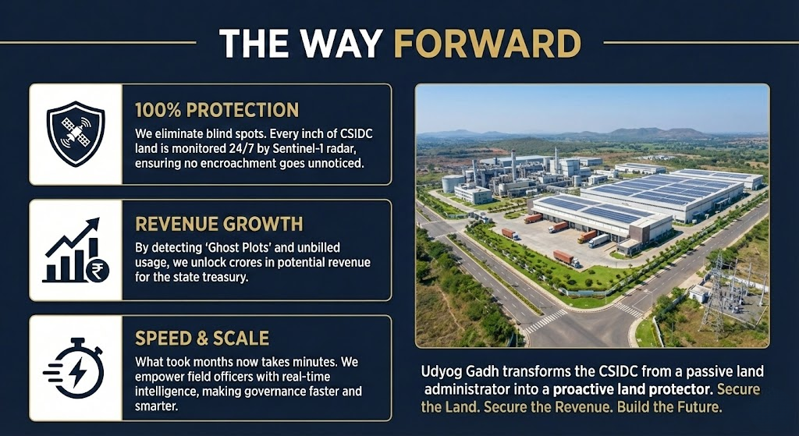
The Way Forward
Conclusion 01 :
100% Protection
We eliminate blind spots. Every inch of CSIDC land is monitored 24/7 by Sentinel-1 radar, ensuring no encroachment goes unnoticed
Udyog Gadh transforms the CSIDC from a passive land administrator into a proactive land protector.
We are not just digitizing maps; we are building a transparent, revenue-generating ecosystem. By eliminating blind spots and automating enforcement, we ensure that every inch of industrial land contributes to Chhattisgarh’s growth.
Conclusion 02 :
Revenue Growth
By detecting 'Ghost Plots' and unbilled usage, we unlock crores in potential revenue for the state treasury.
Conclusion 03 :
Speed and Scale
What took months now takes minutes. We empower field officers with real-time intelligence, making governance faster and smarter.

Slide 11
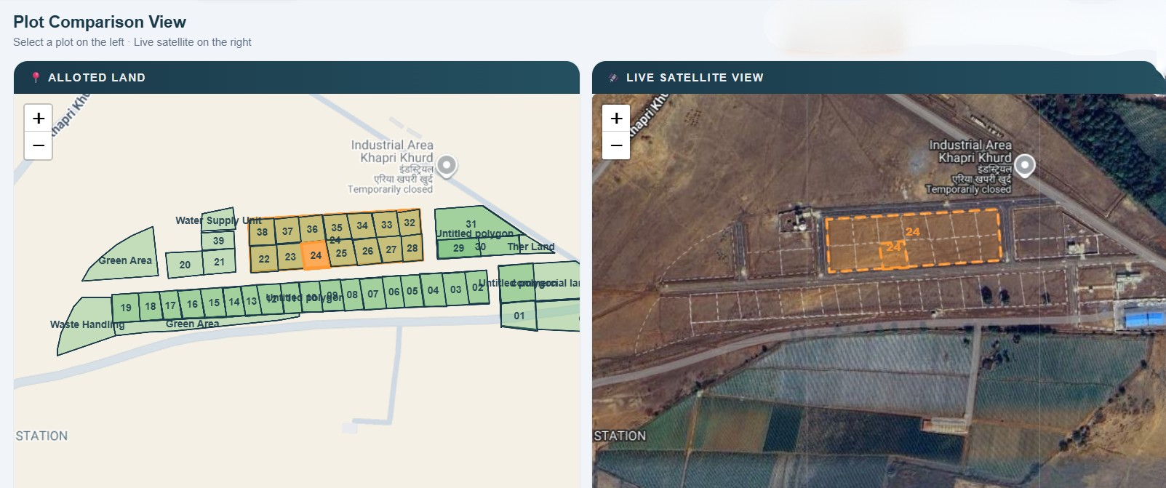
Thank
You
By: Shataksha Raj Sharma
Shanay Sahu
Varsha Gupta
Aayushi Bagmar
From: IIIT NAYA RAIPUR

